Slide 1
Introduction to Programming
Introduction to Computer, Program and Programming
Dr. Gang CHEN (chengang@genomics.cn)
Sep 12th, 2015

Slide 2
Introduction to Programming
Outline
1. Computer
2. Computer Program
3. Programming
4. Course and References

Slide 3
Introduction to Programming
Outline
1. Computer
2. Computer Program
3. Programming
4. Course and References

Slide 4
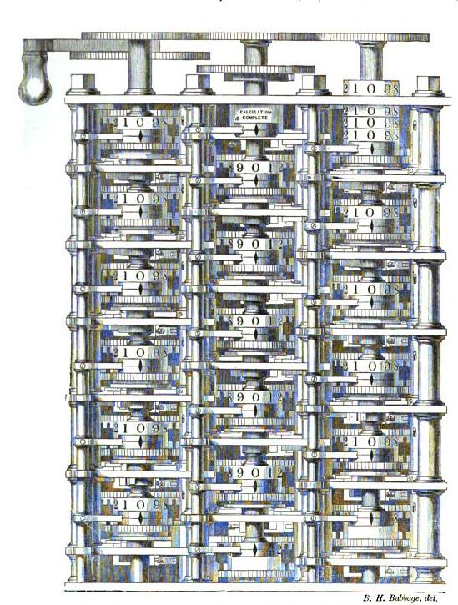
Introduction to Programming
What is Computer?
Benjamin Herschel Babbage
Father of the computer
1853, Difference engine plate

Slide 5
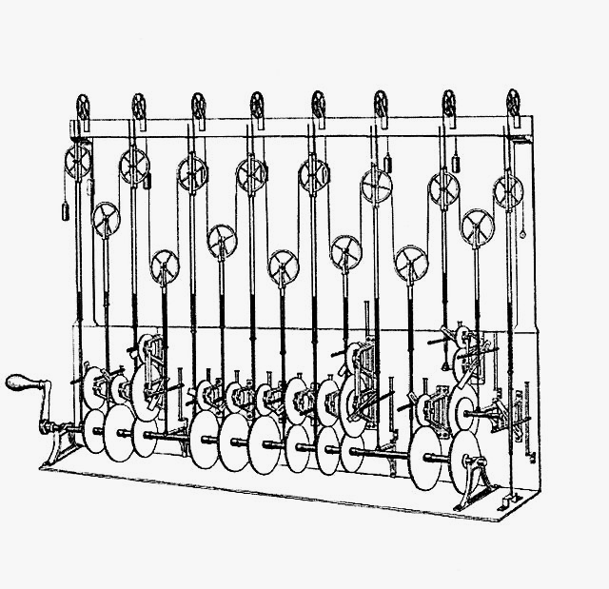
Introduction to Programming
What is Computer?
Sir William Thomson's
third tide-predicting machine design,
1879

Slide 6

Introduction to Programming
What is Computer?
the first electronic programmable and Turing-complete computer ENIAC, 1946

Slide 7
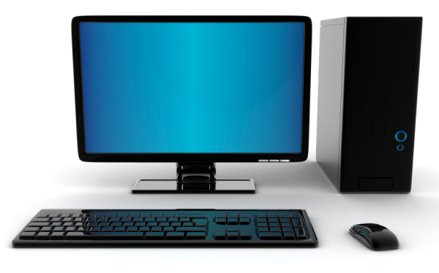
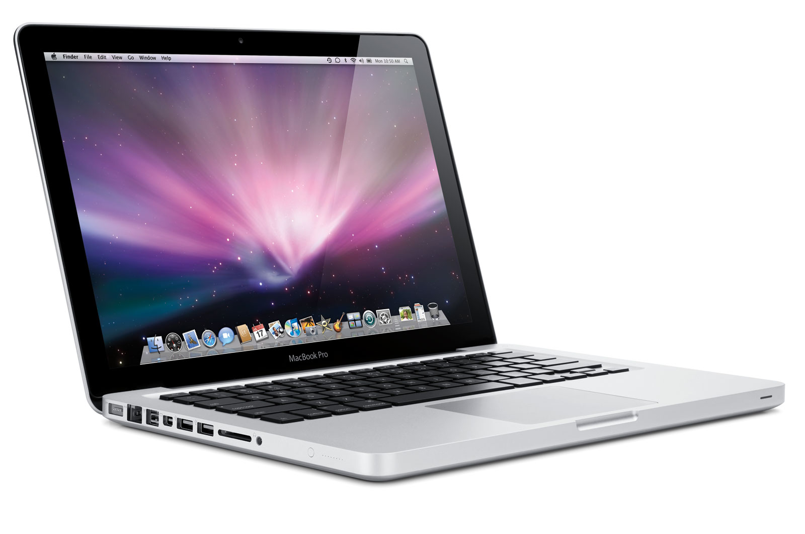
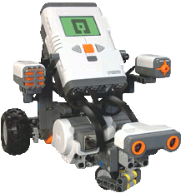
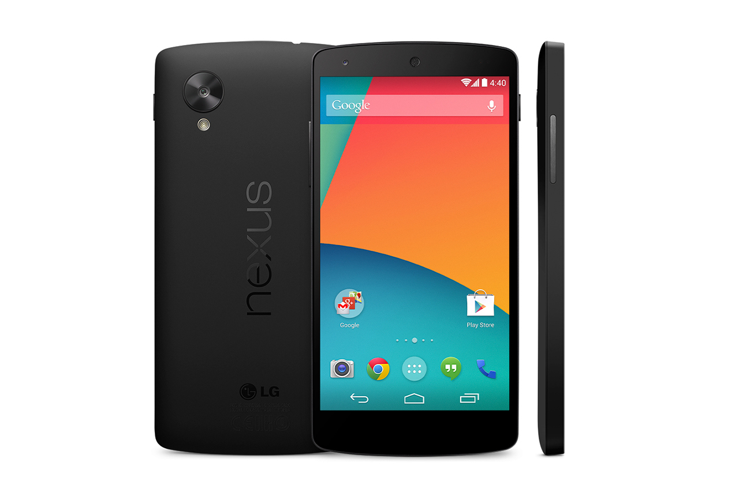
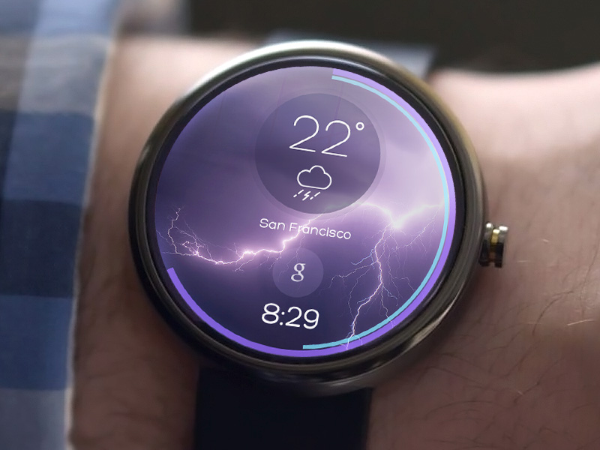
Introduction to Programming
What is Computer?
Notes:
Desktop Computer, Macbook Pro
Nexus 5 smartphone from Google, Moto 360 smart watch, LEGO bot

Slide 8
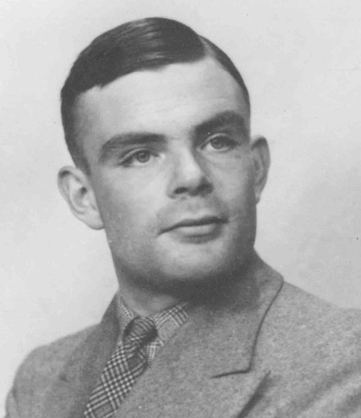
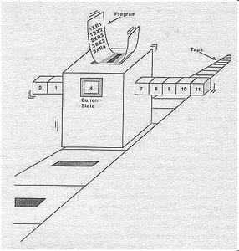
Introduction to Programming
What is Computer?
From Mathematical Perspective: Turing Machine

Slide 9
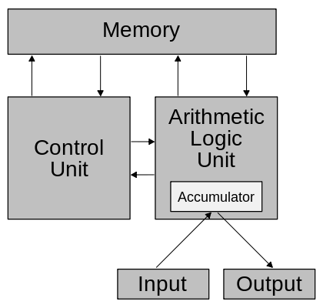
Introduction to Programming
What is Computer?
From Architectural Perspective: Von Neumann Scheme

Slide 10
Introduction to Programming
Outline
1. Computer
2. Program
3. Programming
4. Course and References

Slide 11
Introduction to Programming
Computer Program
A computer program is a sequence of instructions, written to perform a specified task with a computer.
Computer Program = Algorithm + Data Structure
-----Wirth, Niklaus (1976). Algorithms + Data Structures = Programs. Prentice-Hall.
Notes:
Program is used to control the computer to perform a specified task.

Slide 12
Introduction to Programming
Computer Program
Data Structure: how to efficiently store data in computer.

Slide 13
Introduction to Programming
Computer Program
Algorithm: how to efficiently operate data in computer.

Slide 14
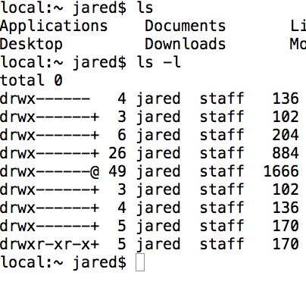
Introduction to Programming
Computer Program
Example

Slide 15
Introduction to Programming
Outline
1. Computer
2. Computer Program
3. Programming
4. Course and References

Slide 16
Introduction to Programming
Programming
Programming is the process to design and implement a computer program.
Programming is the process to write a sequence of instructions to perform a specified task with a computer.
Programming is the process to design and implement the data structure and algorithm to perform a specified task with a computer.
Notes:
We need something to describe data structure and algorithm in the way that can be understood by computer.

Slide 17
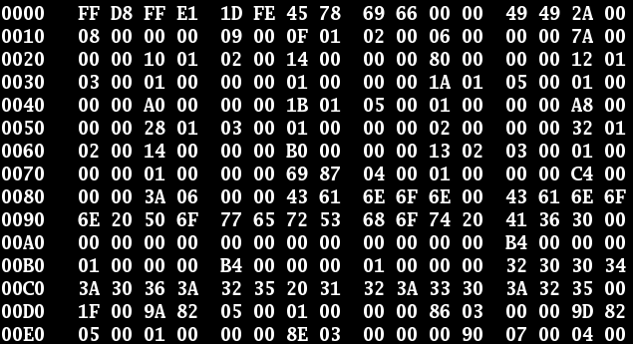
Introduction to Programming
Interaction with Computer
Binary File: can be understood by computer
But cannot be understood by human
Notes:
But we cannot develop program in this way. The binary file cannot be understood by human.

Slide 18
Introduction to Programming
Interaction with Computer
Please print “hello world” on the screen.
Could you please list all files and subdirectories of my home directory?
I want to visit Facebook.com and send a message to my friend.
Natural Languages: can be understood by human
But cannot be understood by computer
Notes:
But we cannot develop program in this way. The binary file cannot be understood by human.

Slide 19
Introduction to Programming
Programming Language
A programming language is a formal constructed language designed to communicate instructions to a computer.
print “Hello World!\n” (Perl)
“Communicate” means the information should be understood by both sides, computer and human.
Notes:
But we cannot develop program in this way. The binary file cannot be understood by human.

Slide 20
Introduction to Programming
Types of Programming Languages
By Implementation:
Compiled: C/C++ and JAVA
Interpreted: Perl and Python
By Programming Paradigm:
Procedural programming: C and Perl
Object-oriented programming: C++, JAVA,R and Python
Notes:
But we cannot develop program in this way. The binary file cannot be understood by human.

Slide 21
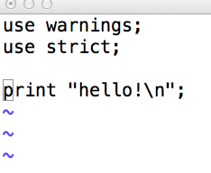
Introduction to Programming
Concepts in Programming:
Source Codes: the program written in a programming language.
Notes:
But we cannot develop program in this way. The binary file cannot be understood by human.

Slide 22
Introduction to Programming
Concepts in Programming:
Source Codes Editor: the program used to write source codes.
Emacs: Unix, Mac, Windows (http://www.gnu.org/software/emacs/)
VIM: Unix, Mac, Windows(http://www.vim.org)
Notepad++: Windows(http://notepad-plus-plus.org)
Sublime Text: Unix, Mac, Windows (http://www.sublimetext.com)
TextMate: Mac
……..
Notes:
But we cannot develop program in this way. The binary file cannot be understood by human.

Slide 23
Introduction to Programming
Concepts in Programming:
Complier: the program used to translate the sources codes in compiled programming languages to the executable file before executing.
GCC for C/C++ (http://gcc.gnu.org)
javac of JDK for JAVA (http://java.oracle.com)
Notes:
But we cannot develop program in this way. The binary file cannot be understood by human.

Slide 24
Introduction to Programming
Concepts in Programming:
Interpreter: the program used to translate the sources codes in interpreted programming languages to the executable codes when executing.
python for Python (https://www.python.org)
perl for Perl (http://www.perl.org)
R for R (http://www.r-project.org)
Notes:
But we cannot develop program in this way. The binary file cannot be understood by human.

Slide 25
Introduction to Programming
Concepts in Programming:
Integrated Development Environment (IDE): a software application that provides comprehensive facilities to computer programmers for software development.
Code Blocks for C/C++
Eclipse for JAVA
Rstudio for R
Notes:
But we cannot develop program in this way. The binary file cannot be understood by human.

Slide 26
Introduction to Programming
Outline
1. Computer
2. Computer Program
3. Programming
4. Course and References

Slide 27
Introduction to Programming
Course
Introduction to Perl
Introduction to R
Introduction to C
Introduction to JAVA
Introduction to Python
………

Slide 28
Introduction to Programming
Course
Introduction to Programming
Basic knowledge of computer;
C/C++: the most powerful compiled language;
Perl: a script language that widely used in Bioinformatics;
R: a language for data analysis and visualization;
Other programming languages, including Java, Python, Golang and so on.
Programming in real bioinformatics.

Slide 29
Introduction to Programming
Course
Introduction to Programming, schedule:
Introduction to Computer and Programming
Lecture 2 & 3: C/C++
Lecture 4 & 5 & 6: Perl
Lecture 7 & 8 & 9: R
Lecture 10: other widely used programming languages
Lecture 11 & 12: best practices I & II
Gang CHEN, Lecture 13: Exam

Slide 30
Introduction to Programming
Course
Introduction to Programming, assignments:
3 assignments for each programming language
Assessment scheme (percentage contributing to the final grade) :
Attendance: 5%
Assignments:45% (15% for each)
Final examination:50%

Slide 31
Introduction to Programming
Course Website:
https://github.com/gangchen/CUHK-I2P

Slide 32
Introduction to Programming
Reference
Computer and Programming:
Randal E. Bryant and David O’Hallaron, Computer Systems: A Programmer’s Perspective, 深入理解计算机系统
Brian W. Kernighan and Pob Pike, The Practice of Programming, 程序设计实践
Steve McConnell, Code Complete 2, 代码大全2

Slide 33
Introduction to Programming
Reference
C:
Brian W. Kernighan and Dennis M. Ritchie, The C Programming language, C程序设计语言
Bjarne Stroustrup, The C++ Programming Language, C++程序设计语言
Book list: http://book.douban.com/doulist/273136/

Slide 34
Introduction to Programming
Software for C/C++:
Software: Code Blocks (http://www.codeblocks.org)
Download: http://www.codeblocks.org/downloads/binaries
Installation:
http://wiki.codeblocks.org/index.php?title=Installing_Code::Blocks
GCC:
http://gcc.gnu.org

Slide 35
Introduction to Programming
Reference
Perl:
Randal L. Schwartz, Learning Perl, Perl入门
Brian D. Foy, Mastering Perl, 精通Perl
Sriram Srinivasan, Advanced Perl Programming, 高级Perl编程
Larry Wall, The Perl Programming Language, Perl语言编程

Slide 36
Introduction to Programming
Software for Perl:
Software:
Perl is pretinsalled in most Linux distributions and Mac OS
Active Perl is designed for Windows
(http://www.activestate.com/activeperl)

Slide 37
Introduction to Programming
Reference
R:
R in Action, R语言实战
R in a nutshell, R语言核心技术手册
ggplot2:elegant graphics for data analysis, ggplot2:数据分析与图形艺术

Slide 38
Introduction to Programming
Software for R:
Software:
R support all main-stream OS (http://www.r-project.org)
Rstudio is highly recommended (http://rstudio.com)

Slide 39
Introduction to Programming
Reference
JAVA:
Cay S. Horstmann and Gary Cornell, Core Java 9th Edition, JAVA核心技术
Kathy Sirerra and Bert Bates, Head First Java,
Bruce Eckel, Thinking in JAVA, Java编程思想

Slide 40
Introduction to Programming
Software for JAVA:
Software:
Java Development Kit (http://www.codeblocks.org)
Eclipse(http://eclipse.org/)

Slide 41
Introduction to Programming
Reference
Python:
Lutz. M. Learning Python 3rd Edition, 学习Python
Magnus Lie Hetland, Beginning Python: from Novice to Professional, 2nd Edition, Python基础教程
Lovely Python，可爱的Python,(Chinese Only)

Slide 42
Introduction to Programming
Software for Python:
Software:
Python is pretinsalled in most Linux distributions and Mac OS
Python for Windows can be found on the official website(https://www.python.org/)

Slide 43
Introduction to Programming
Reference
other:
Go: www.golang.org
Haskell, Ocaml, Matlab, Shell, LaTeX …

Slide 44
Introduction to Programming
Thanks!

